Slide 1
Stacks And Queues
Cool data structures

Slide 2
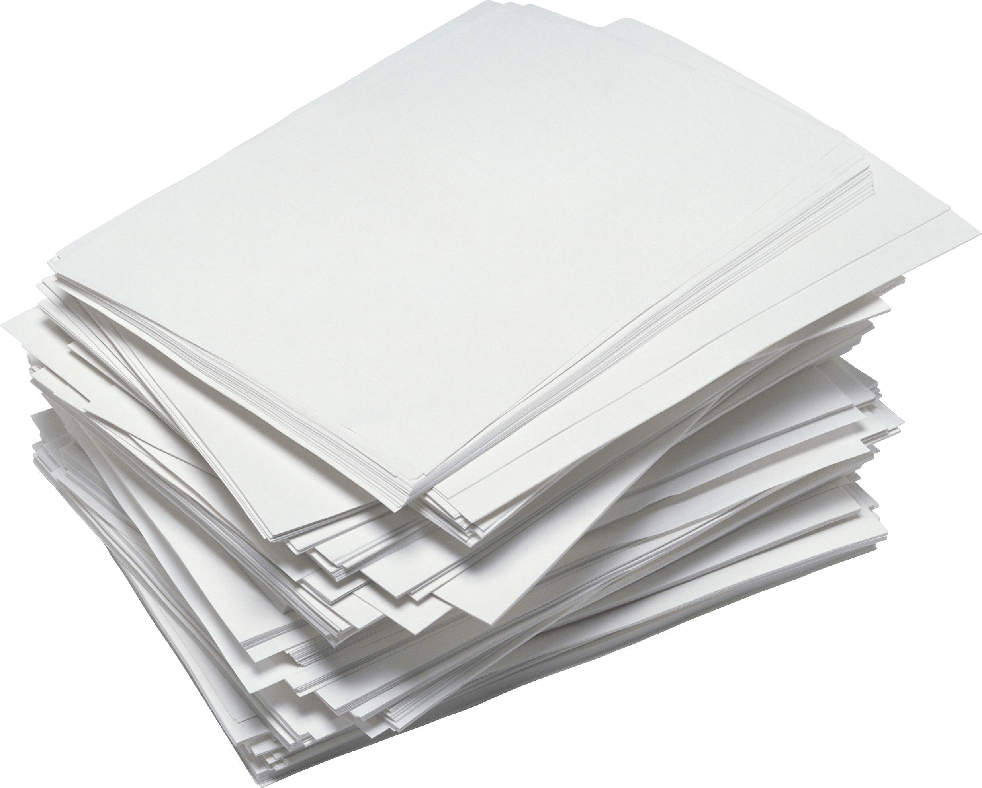
Stacks
Last in, First out (LIFO)
The last element to be added to the stack will be the first element removed
Imagine a stack of paper…
The paper last put on the stack is at the top. This is the first piece of paper you will take
Python: s = [] #use .pop() and .append()
Java: Stack<Integer> st = new Stack();
C++: stack<int> st;

Slide 3
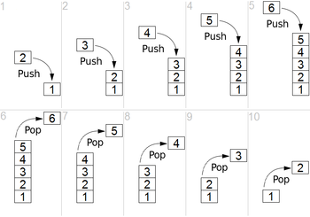
Visualization

Slide 4

Queues
First in, First out (FIFO)
The first element added to the stack will be the first element to be removed
Imagine a queue of people lining up to a movie
The first person to line up will be the first person to enter the theater
*Important data structure for graph theory (BFS)*
Python: q = deque() #Use deque like queue
Java: Queue<Integer> q = new LinkedList();
C++: queue<int> q;

Slide 5
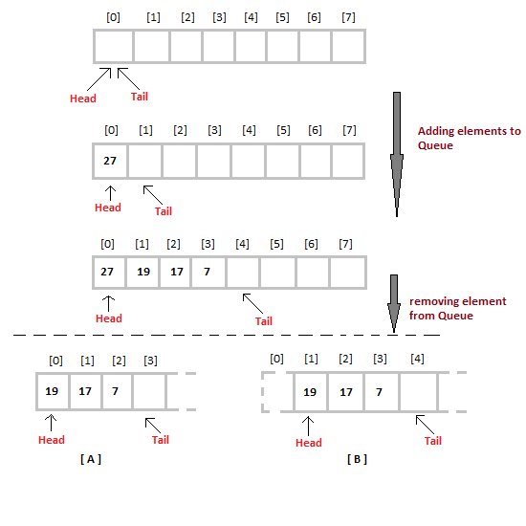
Visualization

Slide 6
Deque
Double ended queue (can take out from both front and back)
When adding elements, you need to specify whether you are adding it to the front or to the end
Same concept with removing an element
Example: A one lane road full of cars (only the first car and the last car can leave the road, the others cannot)
Python: dq = deque()
Java: Deque<Integer> dq = new LinkedList();
C++: deque<int> dq;

Slide 7
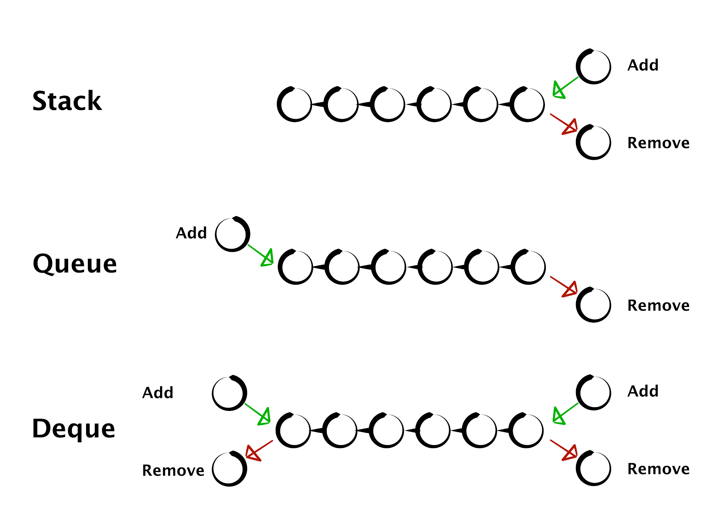
Summary

Slide 8
Problems
https://dmoj.ca/problem/ccc14s3
https://dmoj.ca/problem/stack1
https://dmoj.ca/problem/mwc15c2p2

